Slide 1


McDonald's: More Than Just Fast Food
Larry
Sep 25, 2025

Slide 2
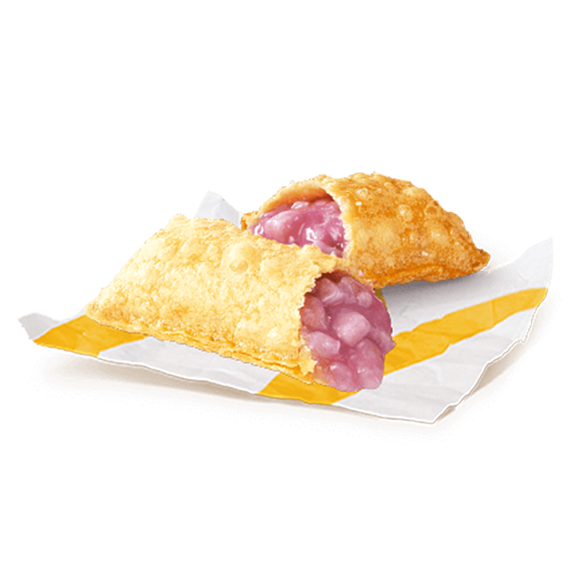
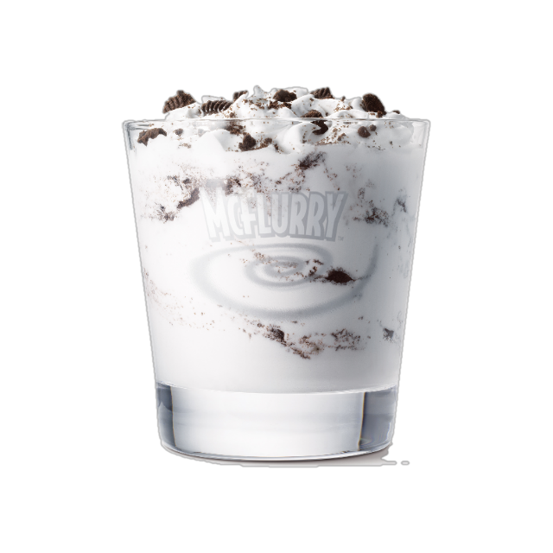

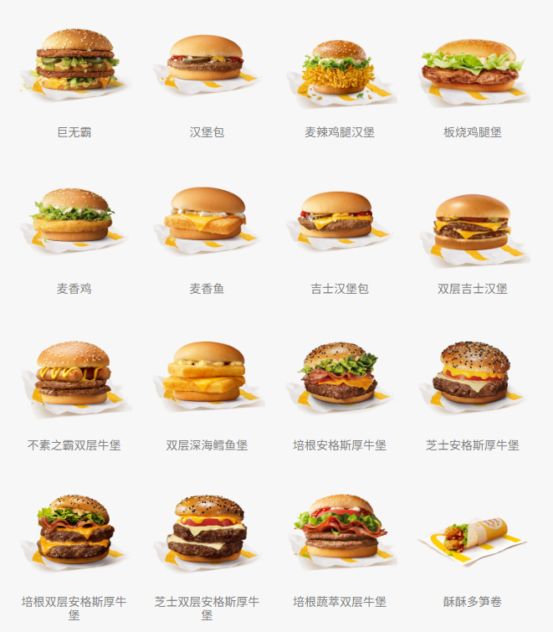
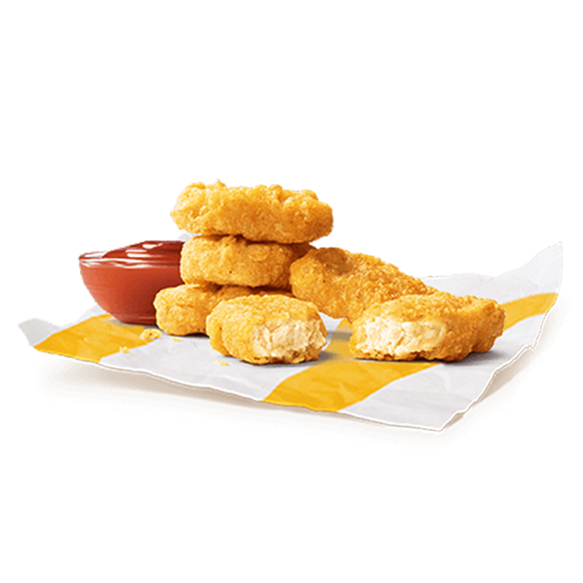

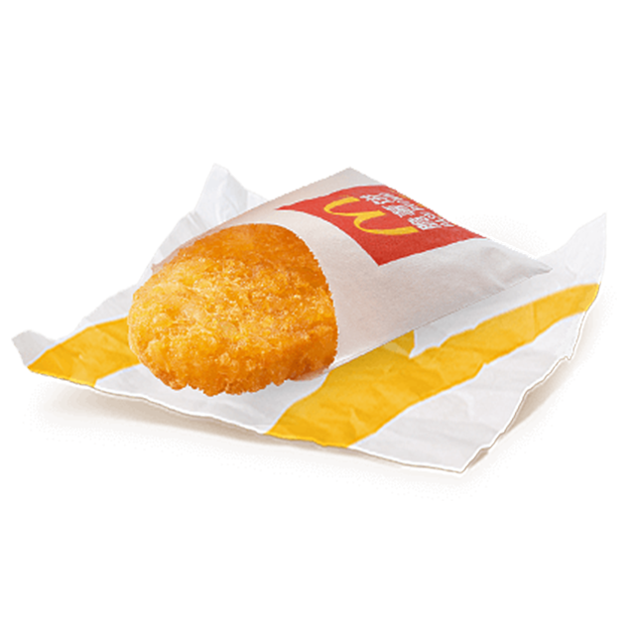

What's Your Favorite Item in McDonald’s?

Slide 3
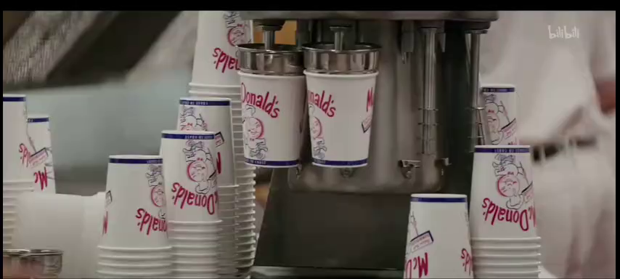
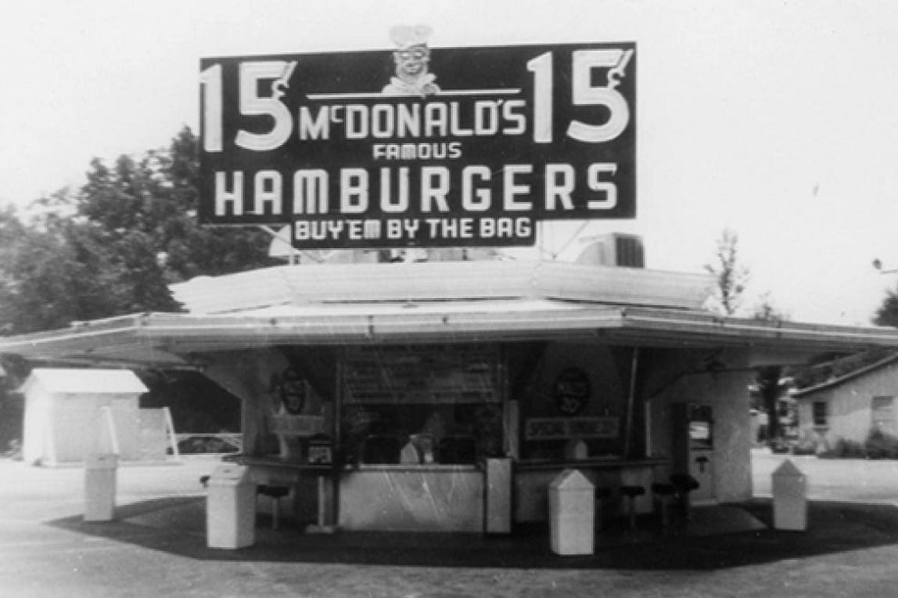
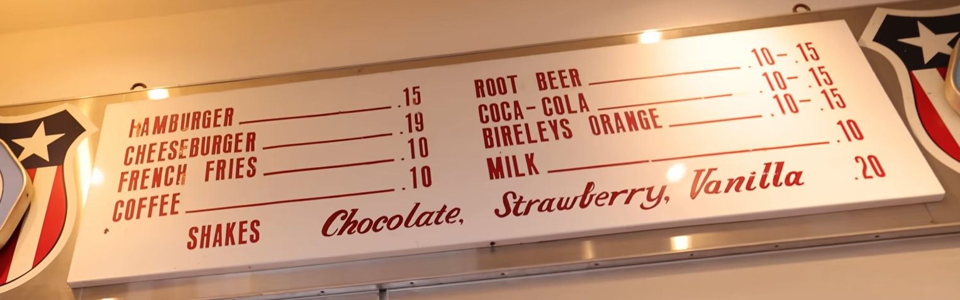
It All Started with Speed...
Founders: Richard & Maurice McDonald
When & Where: 1940, California
Key Innovation: The "Speedee Service System"
An assembly-line (流水线) method for making food.
Revolutionary idea: Made food faster, cheaper, and consistent.

Slide 4
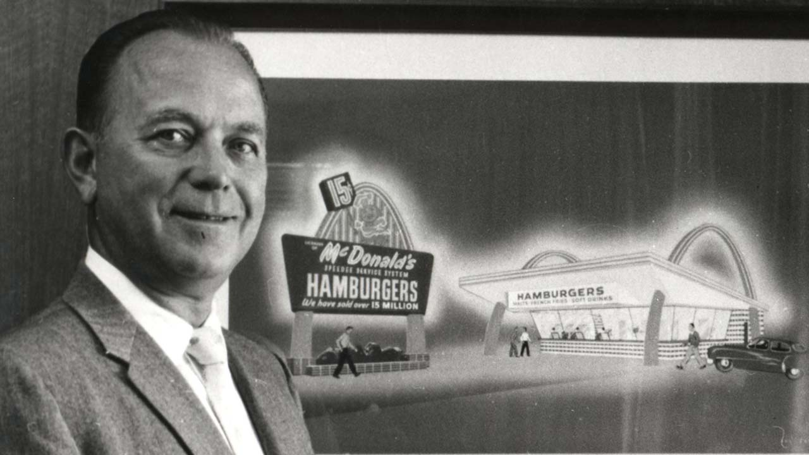
The Man with a Vision
Ray Kroc is widely credited (赞许) as the visionary who transformed McDonald's into the global fast-food empire it is today. Originally a milkshake machine salesman, he was impressed by the efficiency of the "Speedee Service System" at the McDonald brothers' small restaurant. While the founders were content with their local success, Kroc saw the immense (巨大的) potential for a nationwide franchise (特许经销权). Driven by his ambitious vision, he bought the company in 1961 and, through his relentless determination and business intelligence, led its massive expansion, making the Golden Arches one of the most recognized symbols in the world.
"Luck is a dividend of sweat."
—Ray Kroc

Slide 5
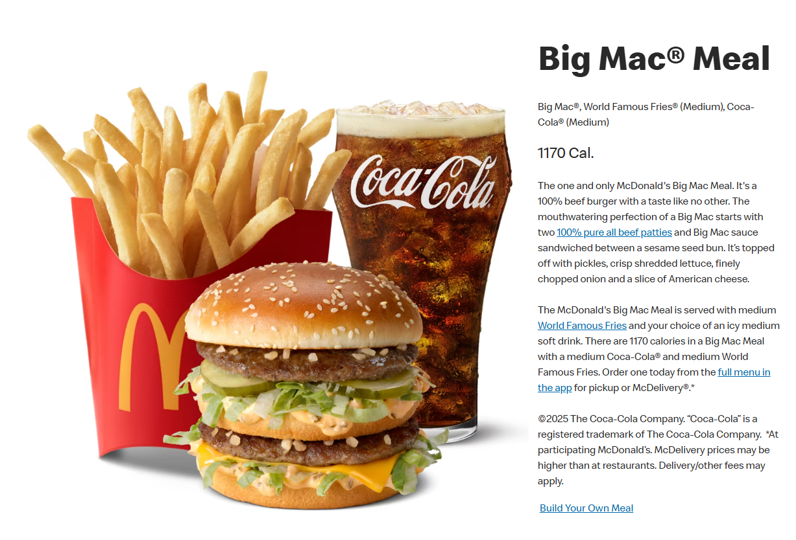
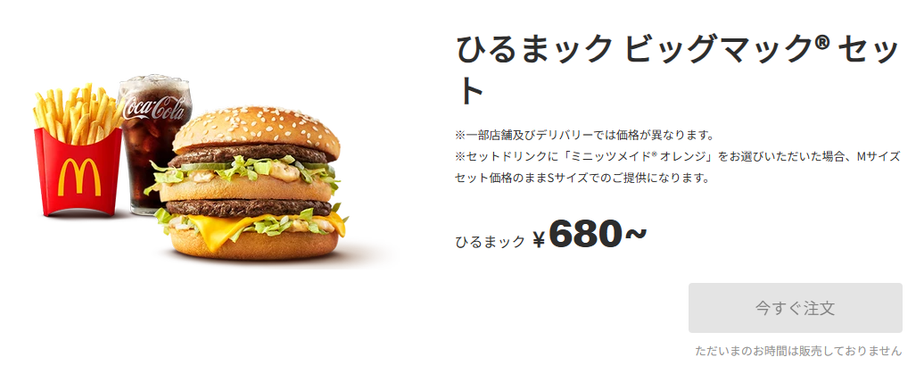
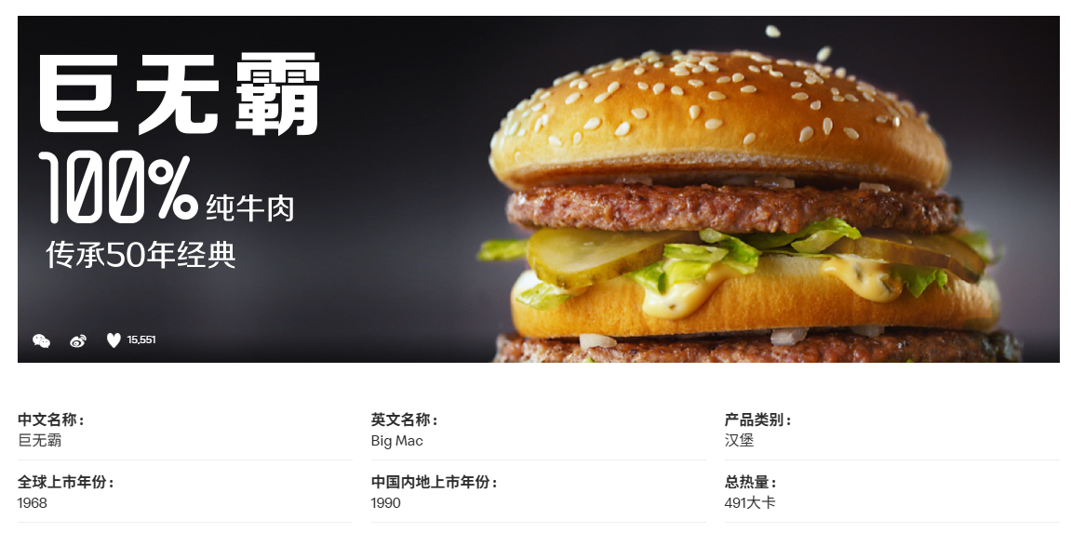
Different? Same? How Did They Conquer (征服) the World?
Consistency: A Big Mac in Tokyo tastes almost the same as one in New York. You always know what you're getting.

Slide 6
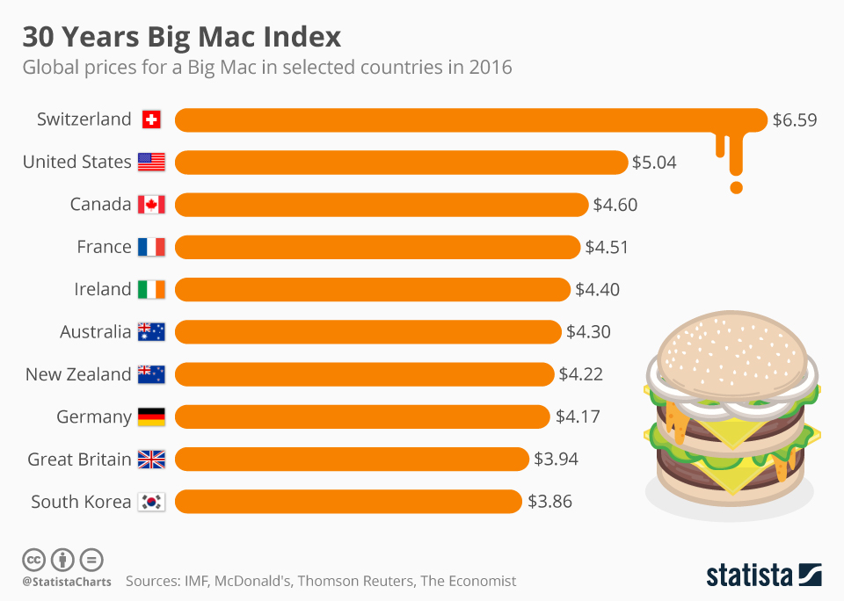
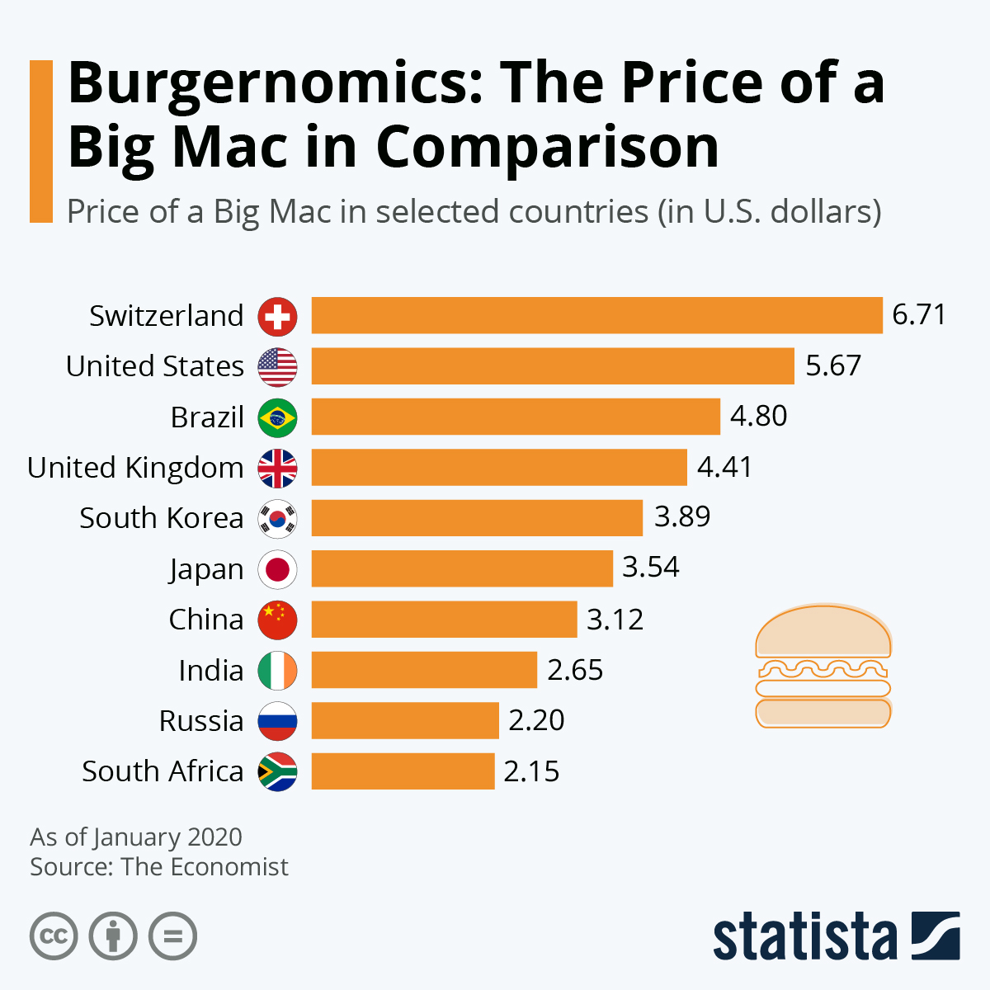
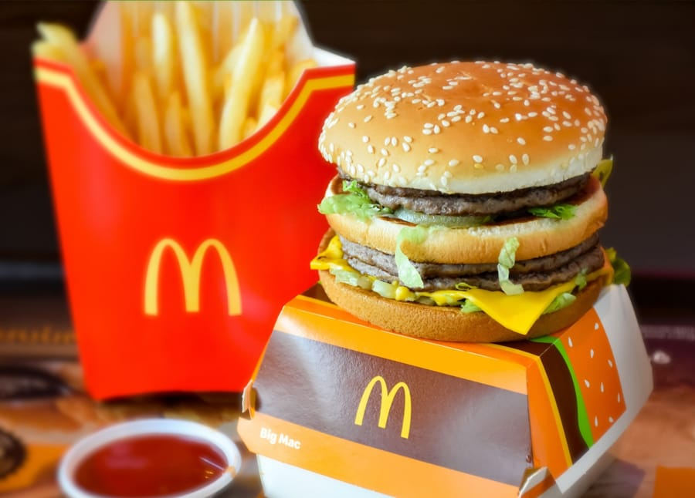
Different? Same? How Did They Conquer the World?
Fun Fact: The Big Mac Index is an informal measure of purchasing power parity (PPP, 购买力平价) between currencies, based on the price of a Big Mac in different countries. Since 1986, The Economist magazine has used the Big Mac Index to compare the purchasing power of currencies globally. They call it 'Burgernomics'.

Slide 7
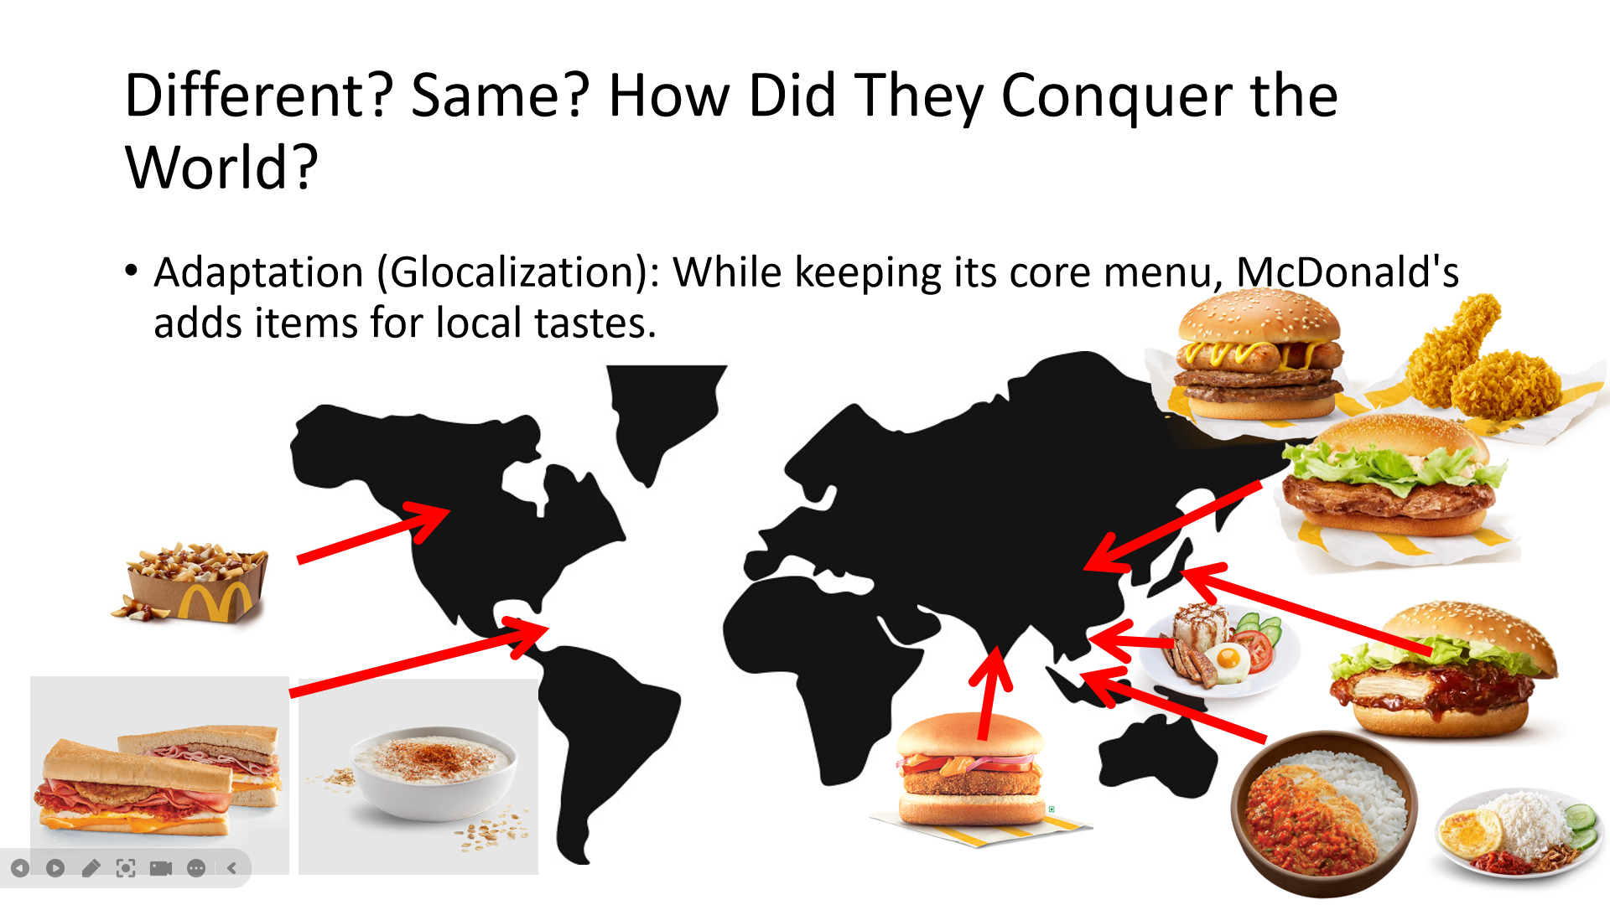
Adaptation (Globalization) : While keeping its core menu all around the world, McDonald’s add new items according to local tastes.a

Slide 8
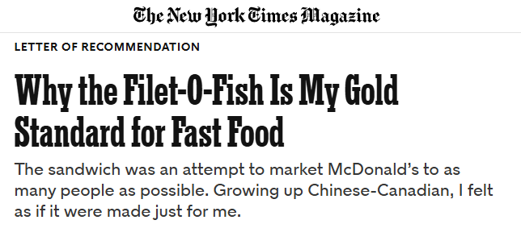
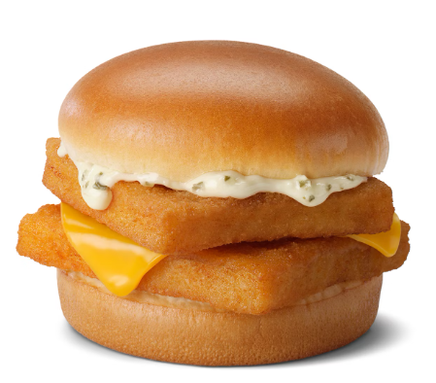

Slide 9
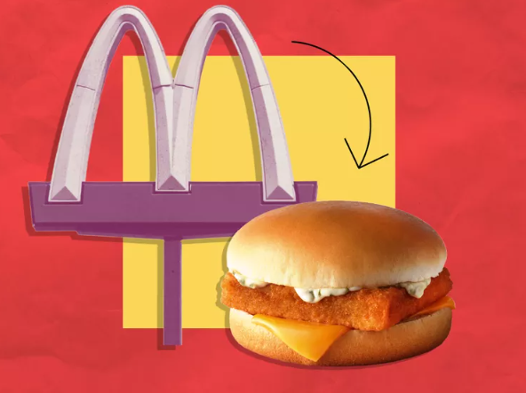
The Filet-O-Fish became my menu item of choice. Its virtues are too many to count; doing so would be futile. As McDonald’s only seafood-based option, the Filet-O-Fish’s semblance of relative health appealed to my parents. Luckily it was also McDonald’s most delicious item. It played to my Chinese palate: While other McDonald’s buns were toasted, the Filet-O-Fish’s was steamed, much like the baozi. From its honeyed starch to its tangy tartar and savory fillet, the taste of the Filet-O-Fish carries an ineffable umami-ness. At once sweet and sour, it reminds me of orange-chicken sauce: a plausibly Chinese flavor mass-produced in America. Eating one always felt transportive — the equivalent of Proust’s madeleine for my Chinese diasporic upbringing.
—Why the Filet-O-Fish Is My Gold Standard for Fast Food
麦香鱼成了我总在菜单上点的东西。它的优点太多了，不可能一一道出。麦香鱼是麦当劳唯一的海味选择，其相对健康的假象对我父母颇有吸引力。幸运的是，它也是麦当劳最美味的食物，迎合了我的中国人口味。麦当劳其他汉堡的包是烤的，麦香鱼的是蒸的，很像包子。从甜甜的面包、滋味沙拉酱到美味的鱼柳，麦香鱼的味道有一种难以形容的鲜。其酸甜参半的味道，让我想起在美国常见的所谓中国菜陈皮鸡。每次吃麦香鱼汉堡都有一种穿越感，对我这种在海外长大的中国人来说，它相当于普鲁斯特的马德琳小蛋糕。

Slide 10
As a child, I was under the fantasy that my obsession(困扰) with such a strange sandwich was eccentric (古怪的). When I went to McDonald’s with friends who got Chicken McNuggets Happy Meals or cheeseburgers, ordering the Filet-O-Fish made me feel as if I was in on some sort of secret. After a few years in Montreal, my dad landed a good government job in Victoria, British Columbia. On our drive across Canada, we indulged in the prospect of my dad’s earning a real salary by eating at McDonald’s almost daily, a whirlwind (旋风) of Filet-O-Fish meals (for me) and hamburgers (for my parents). But my experience was shattered (破碎的) when I, fancying myself different, pointed out that my parents both loved hamburgers while I, a renegade, preferred the Filet-O-Fish. “Well, I like the Filet-O-Fish most too,” my mother put it candidly. “But it is expensive, so we only buy it for you.”
—Why the Filet-O-Fish Is My Gold Standard for Fast Food
在小时候的想象中，我对这种奇怪的三明治的痴迷颇为异乎寻常。当我和朋友们去麦当劳时，他们点的都是麦乐鸡快乐套餐或芝士汉堡等，我点的却是麦香鱼，这让我觉得我似乎知道一个他们不知道的秘密。在蒙特利尔住了几年后，我爸在不列颠哥伦比亚省的维多利亚市找到了一份很好的政府工作。在开车穿越加拿大的路上，我们尽情享受了我爸将挣到真正薪水的前景：几乎每天都要在麦当劳吃饭，我吃麦香鱼套餐，我妈我爸吃汉堡。但当我自以为与众不同，指出我的父母喜欢汉堡，而我却不像他们，更喜欢麦香鱼时，我的经验受到了一次极大的打击。“嗯，我最喜欢的也是麦香鱼，”我妈直言道。“但麦香鱼太贵了，所以我们只给你买。”

Slide 11
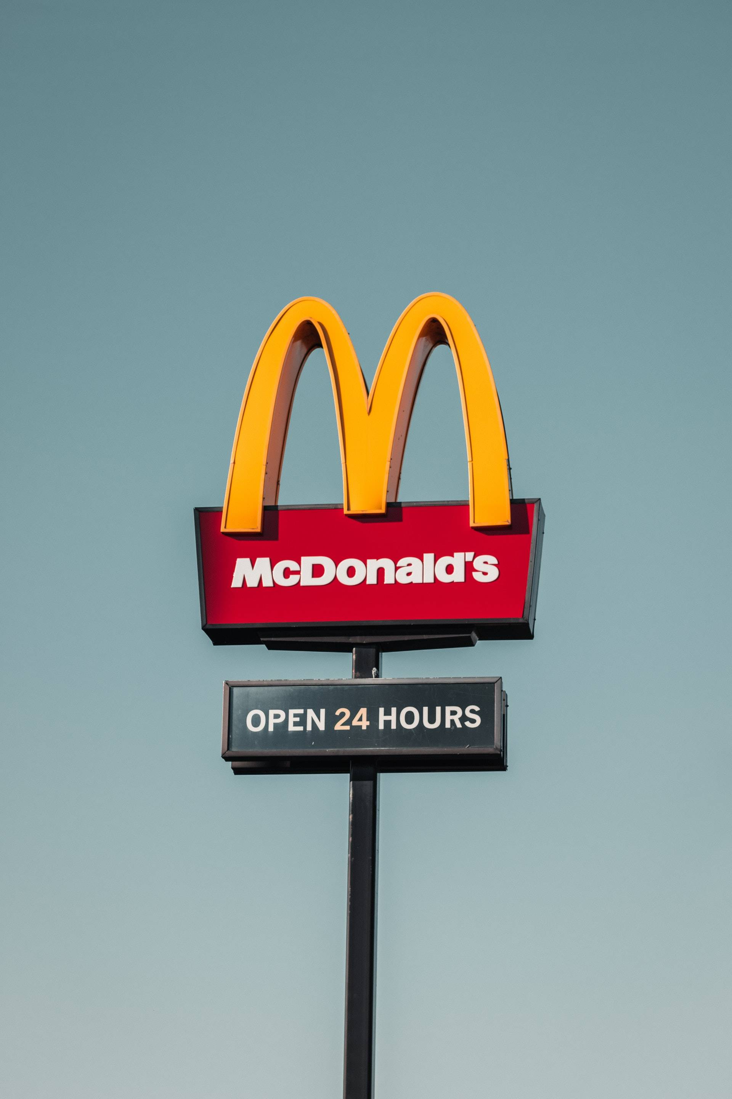


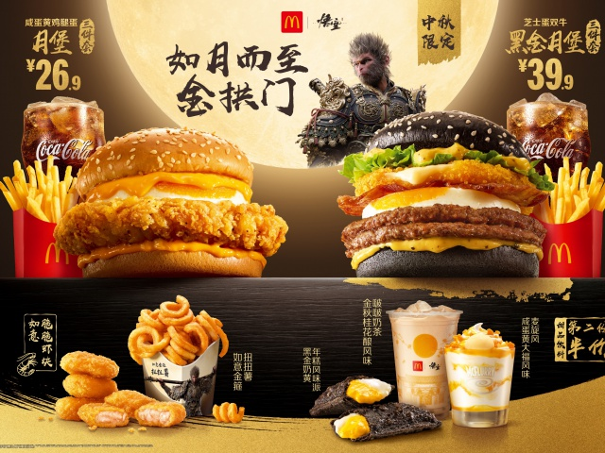
Summary
In summary, we have seen that McDonald's success isn't just about fast service. It’s about the visionary ambition of Ray Kroc, the foundation of the 'Speedee Service System', and the perfect balance between global consistency and local adaptation. This unique blend is symbolized by everything from the serious Big Mac Index to the culturally relevant Filet-O-Fish story. McDonald's is truly a global cultural, economic, and culinary phenomenon.

Slide 12
Thanks for listening!

Slide 13
Word List
Innovation n. 创新，革新
Consistent adj. 始终如一的，味道一致的
Visionary n. 有远见的人
Transform v. 彻底改变，使...改观
Efficiency n. 效率
Relentless adj. 不懈的，持续不断的
Empire n. 帝国 (引申为庞大的企业)
Undervalued adj. 被低估的，价值被低估的
Obsession n. 痴迷，着迷

